Slide 1
ARTIFICIAL Neural Networks (ANN)

Slide 2
TOPICS TO COVER
Artificial Neural Networks
Biological Neurons & Artificial Neurons
Main Components Of Neural Network
How do Neural Networks work
How Do They Learn

Slide 3
Artificial Neural Networks
“Artificial Neural Networks or ANN is an information processing paradigm that is inspired by the way the biological nervous system such as brain process information. It is composed of large number of highly interconnected processing elements(neurons) working in unison to solve a specific problem.”

Slide 4
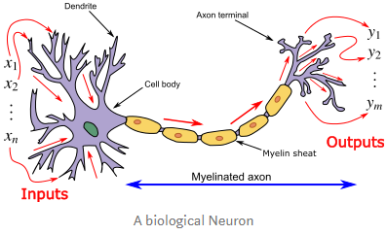
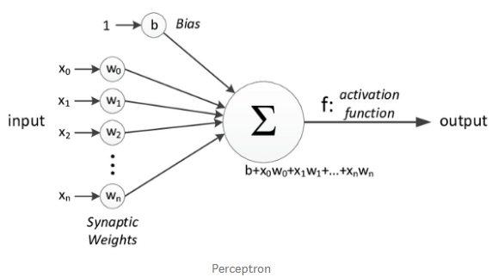
BIOLOGICAL NEURONS & Perceptron
Dendrites receive input through the synapses of other neurons.
The soma(cell body) processes these incoming signals over time and converts
that processed value into an output, which is sent out to other neurons
through the axon and the synapses.
A single layer neural network is called a Perceptron. It gives a single output.
For one single observation, x0, x1, x2, x3...x(n) represents various inputs.
Each of these inputs is multiplied by a connection weight or synapse.
The weights are represented as w0, w1, w2, w3….w(n) .
b is a bias value which allows to shift the activation function up or down.
In the simplest case, these products are summed, fed to a transfer function
(activation function) to generate a result, and this result is sent as output.
Mathematically, x1.w1 + x2.w2 + x3.w3 ...... xn.wn = ∑ xi.wi
Now activation function is applied 𝜙(∑ xi.wi)

Slide 5
Main Components Of Neural Network
Neurons: Set of functions
They take in an input and produce an output.
A number of neurons are grouped into layers. All neurons within the same group perform similar type of function.
Input neurons receive inputs, process it and pass it to the neurons in next successive layer. Hidden neurons take outputs from input neurons, compute new outputs and pass them to successive layers.
2. Layers: Grouping of neurons
Contain neurons and help pass information around.
There are at minimum two layers in a neural network: Input and Output layer.
We can have a large number of layers in a complex neural network.
The layers, other than the input and output layers, are known as hidden layers.

Slide 6
Main Components Of Neural Network (Cont…)
3. Weights & Biases : Numerical Values
These are essentially variables in the model that are updated to improve network’s accuracy. A weight is applied to input of each of the neuron to compute an output.
Neural networks update these weights on continuous basis.
Biases are also numerical values which are added once weights are applied to inputs.
Weights and biases make neural networks self-learning algorithms.
4. Activation Function
Activation function decides whether a neuron should be activated or not by calculating the weighted sum and further adding bias to it.
The motive is to introduce non-linearity into the output of a neuron which is required to solve complex problems.
If we plot non-linear outputs that the activation functions produce, we will get a curvature. The slope of the curve is used to compute the gradient. Gradient helps us in understanding rate of change and relationships of variables.
From the relationships, algorithms are optimized and weights are updated.

Slide 7
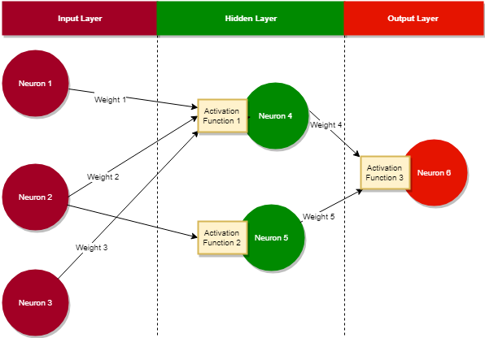
Neural Networks
Inputs are fed into neuron 1, neuron 2 and neuron 3 as they belong to the Input Layer.
Each neuron has a weight associated with it. When an input enters a neuron, the weight on the neuron is multiplied to the input.
Sum of weight * inputs of neurons in a layer is calculated.
Finally an activation function is applied. Output calculated by the neurons becomes input to the activation function which then computes a new output. This output can flow back or to the neurons in the next layer.

Slide 8
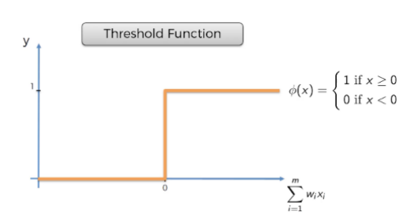
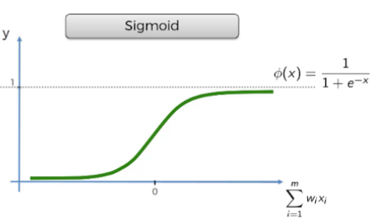
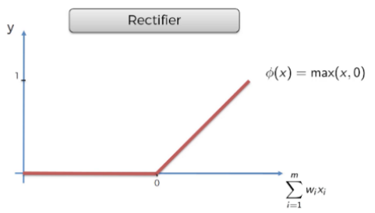
DIFFERENT TYPES OF ACTIVATION FUNCTIONS
Also known as the binary step function, it is a threshold-based activation function.
If the input value is above or below a certain threshold, the Neuron is activated
and sends exactly the same signal to the next layer.
It’s kind of yes or no function.
Mainly used for logistic regression, it’s smoother than the threshold function.
It is also very useful at the output layer of the Neural Network.
It is computationally expensive.
Also known as ReLU function.
It is one of the most popular functions for Neural.
ReLU is a non-linear function and very computationally efficient.

Slide 9
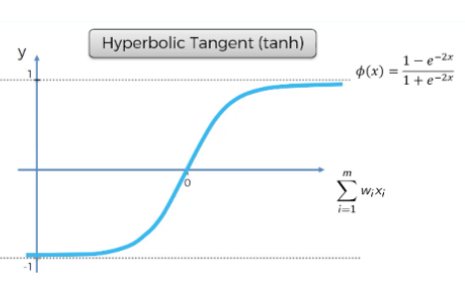
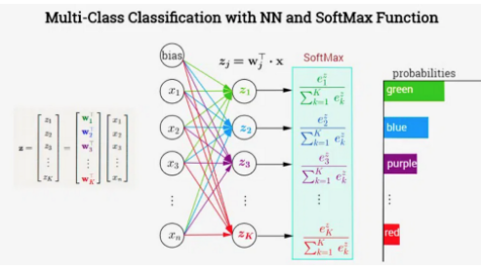
DIFFERENT TYPES OF ACTIVATION FUNCTIONS (Cont…)
It’s similar to Sigmoid but it goes below zero, unlike Sigmoid.
It’s mainly used when the input has strongly negative, neutral, or strongly positive values.
This is mainly used in classification problems for multi-class predictions.
It is typically in the output layer of the Neural Network.

Slide 10
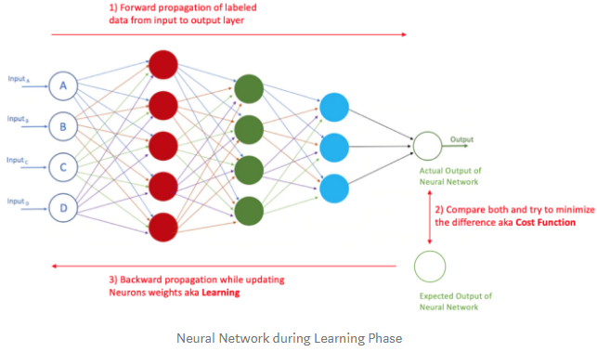
How Do They Learn ?
In the first Epoch, the labeled data is entered at the input layer and
propagated to the output layer where your Neural Network will
calculate an output.
The difference between the actual output of your Neural Network vs.
the expected output is called the Cost Function.
The goal of Neural Network is to decrease this Cost Function
as much as possible.
So, Neural Network will Back-Propagate from the output layer
all the way to the input layer and update the weights of the Neurons
accordingly in an attempt to minimize this Cost Function.
The act of sending the data from the input layer to the output layer then all the way back is called an Epoch.
In each epoch, the Neural Network updates the weights of the Neurons which is also known as Learning.
After multiple Epochs and weight updates, the loss function (the difference between Neural Network output
vs. Actual output) should reach a minimum.

Slide 11
End

